Slide 1
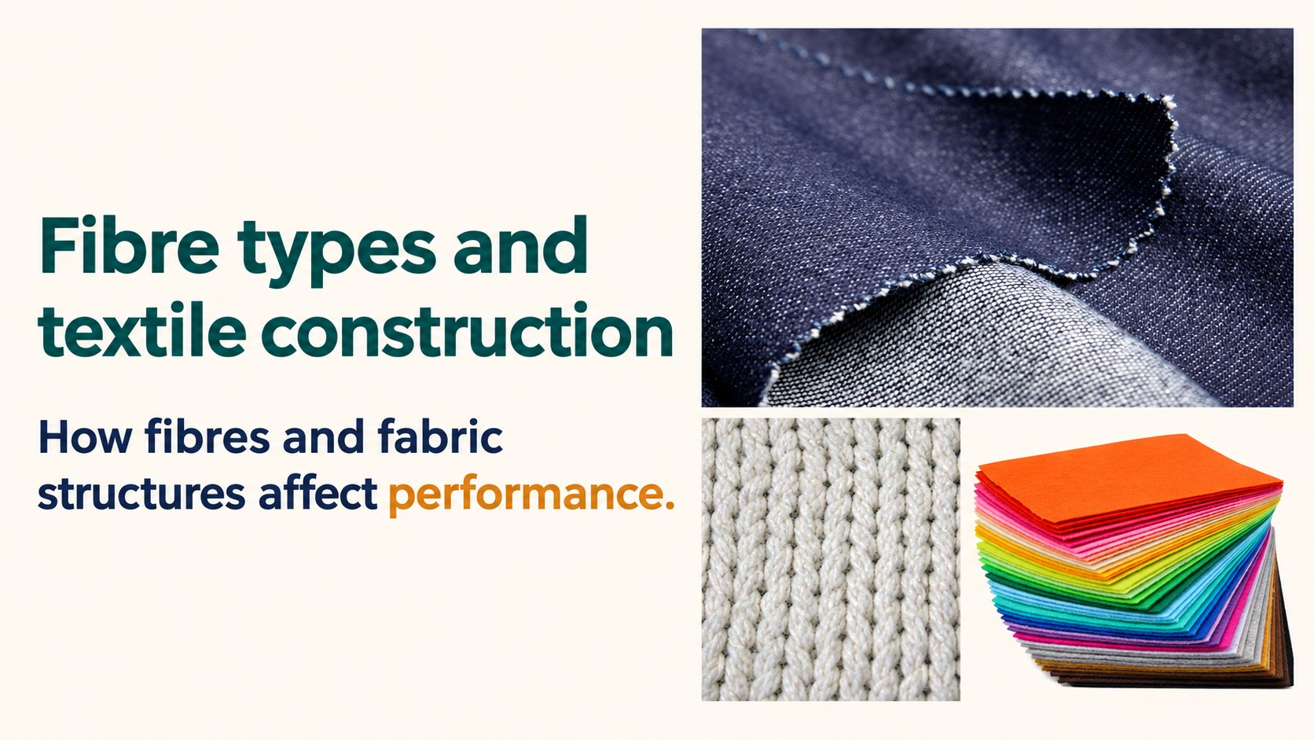
Notes:
Reference: Pearson Edexcel Design & Technology, supplied reference PDF, section 1.11, printed pages 32–34. Topic: Fibre types and textile construction. Slide artwork generated using sourced photographic references.
Performance ratings are textbook revision comparisons, not universal laboratory measurements. Warp knitting uses lengthwise yarns. Weft knitting forms crosswise rows.

Slide 2
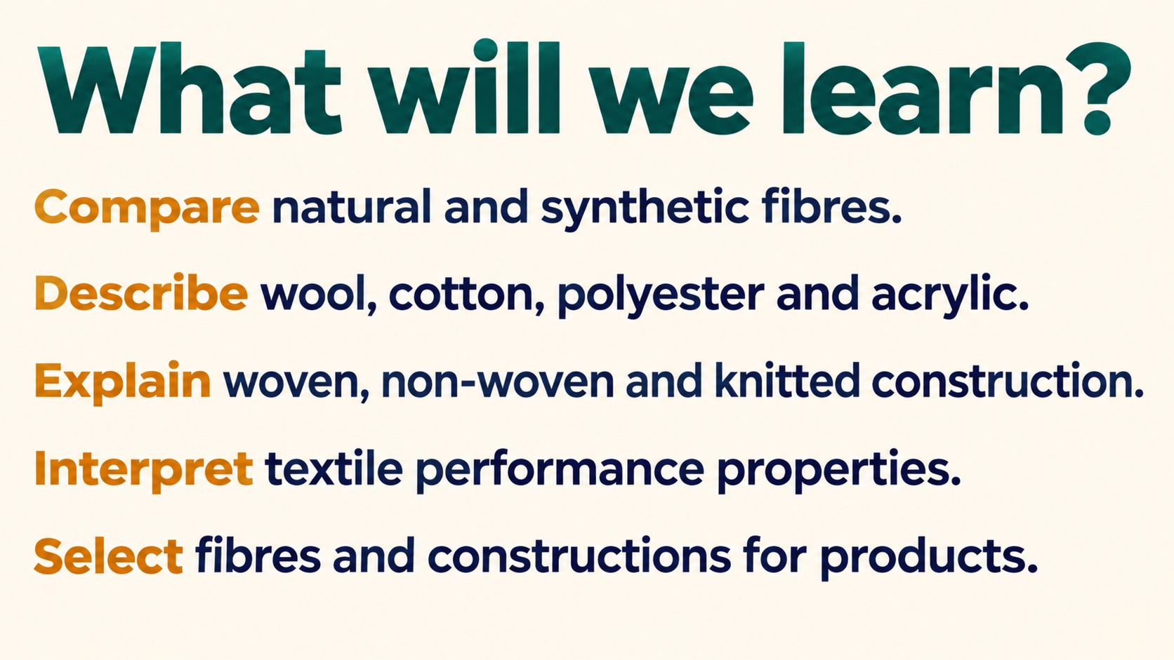
Notes:
Reference: Pearson Edexcel Design & Technology, supplied reference PDF, section 1.11, printed pages 32–34. Topic: Exploring textile fibres and construction(1). Slide artwork generated using sourced photographic references.
Performance ratings are textbook revision comparisons, not universal laboratory measurements. Warp knitting uses lengthwise yarns. Weft knitting forms crosswise rows.

Slide 3
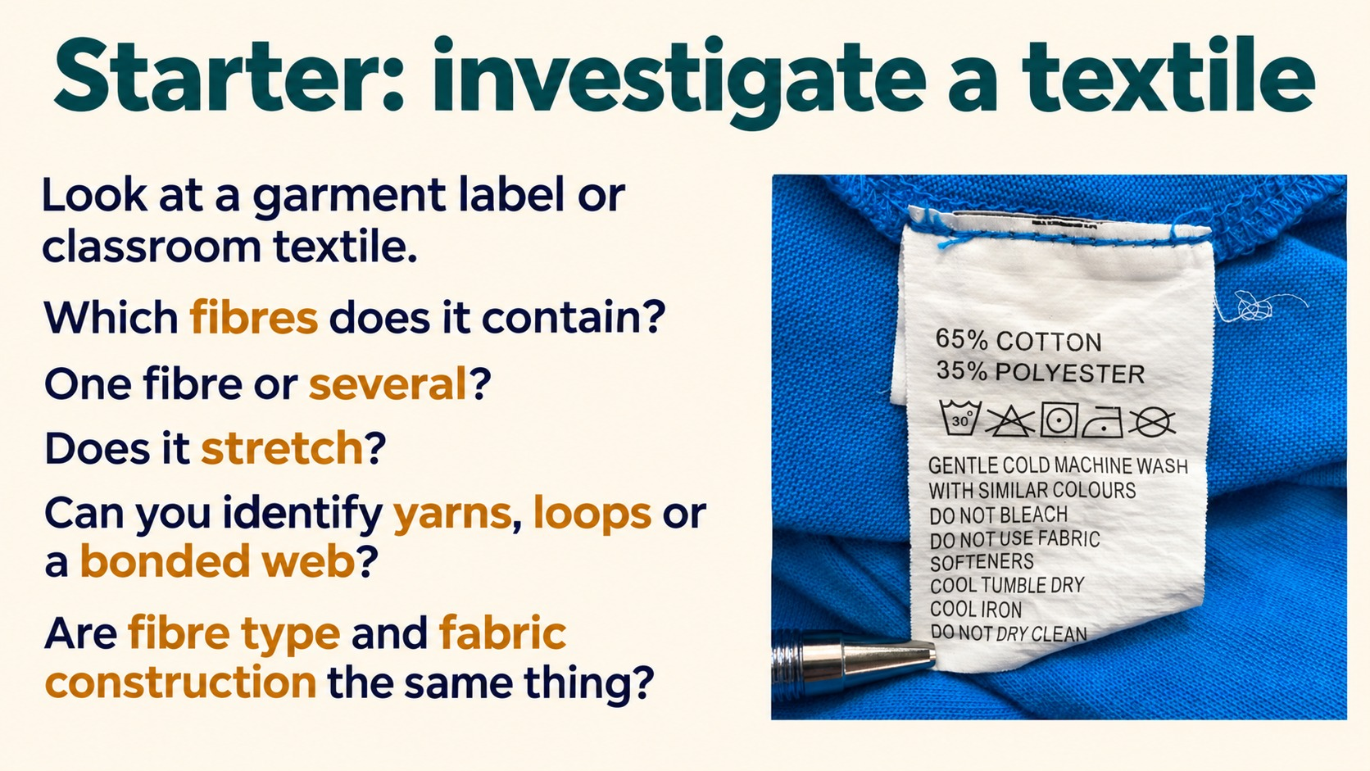
Notes:
Reference: Pearson Edexcel Design & Technology, supplied reference PDF, section 1.11, printed pages 32–34. Topic: Starter: investigate a textile. Slide artwork generated using sourced photographic references.
Performance ratings are textbook revision comparisons, not universal laboratory measurements. Warp knitting uses lengthwise yarns. Weft knitting forms crosswise rows.

Slide 4
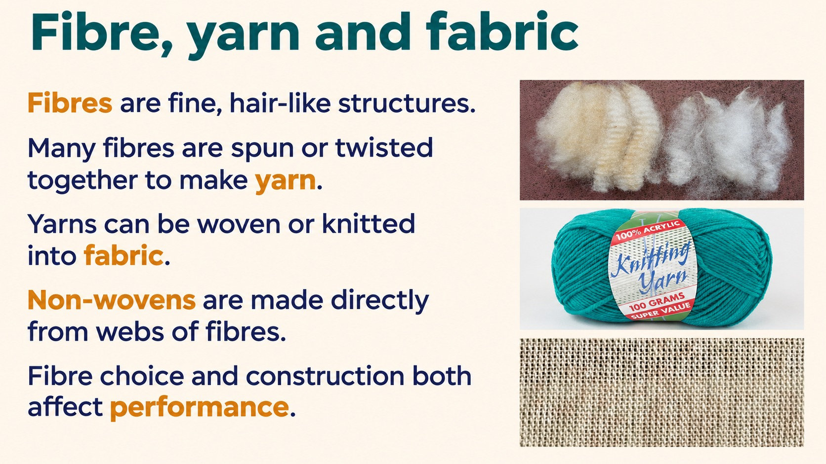
Notes:
Reference: Pearson Edexcel Design & Technology, supplied reference PDF, section 1.11, printed pages 32–34. Topic: Fibre, yarn and fabric. Slide artwork generated using sourced photographic references.
Performance ratings are textbook revision comparisons, not universal laboratory measurements. Warp knitting uses lengthwise yarns. Weft knitting forms crosswise rows.

Slide 5
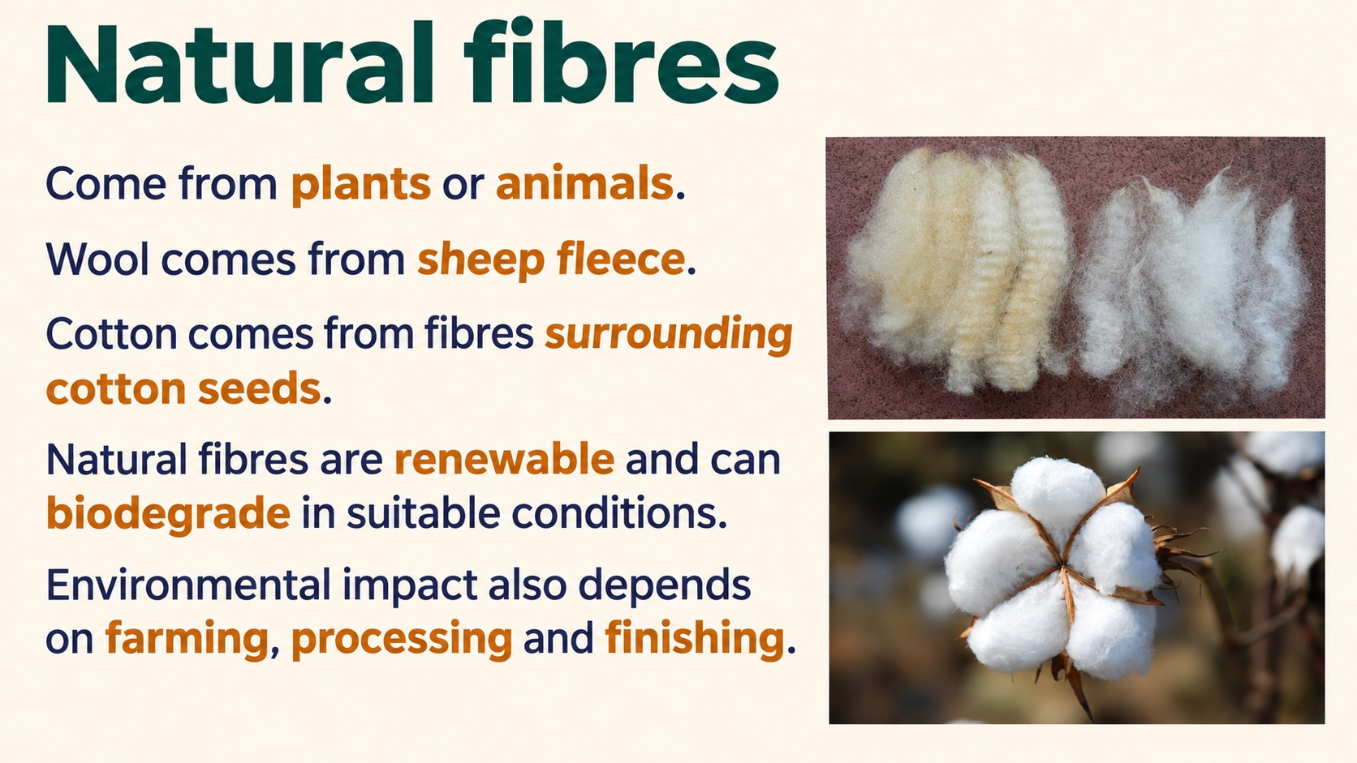
Notes:
Reference: Pearson Edexcel Design & Technology, supplied reference PDF, section 1.11, printed pages 32–34. Topic: Natural fibres. Slide artwork generated using sourced photographic references.
Performance ratings are textbook revision comparisons, not universal laboratory measurements. Warp knitting uses lengthwise yarns. Weft knitting forms crosswise rows.

Slide 6
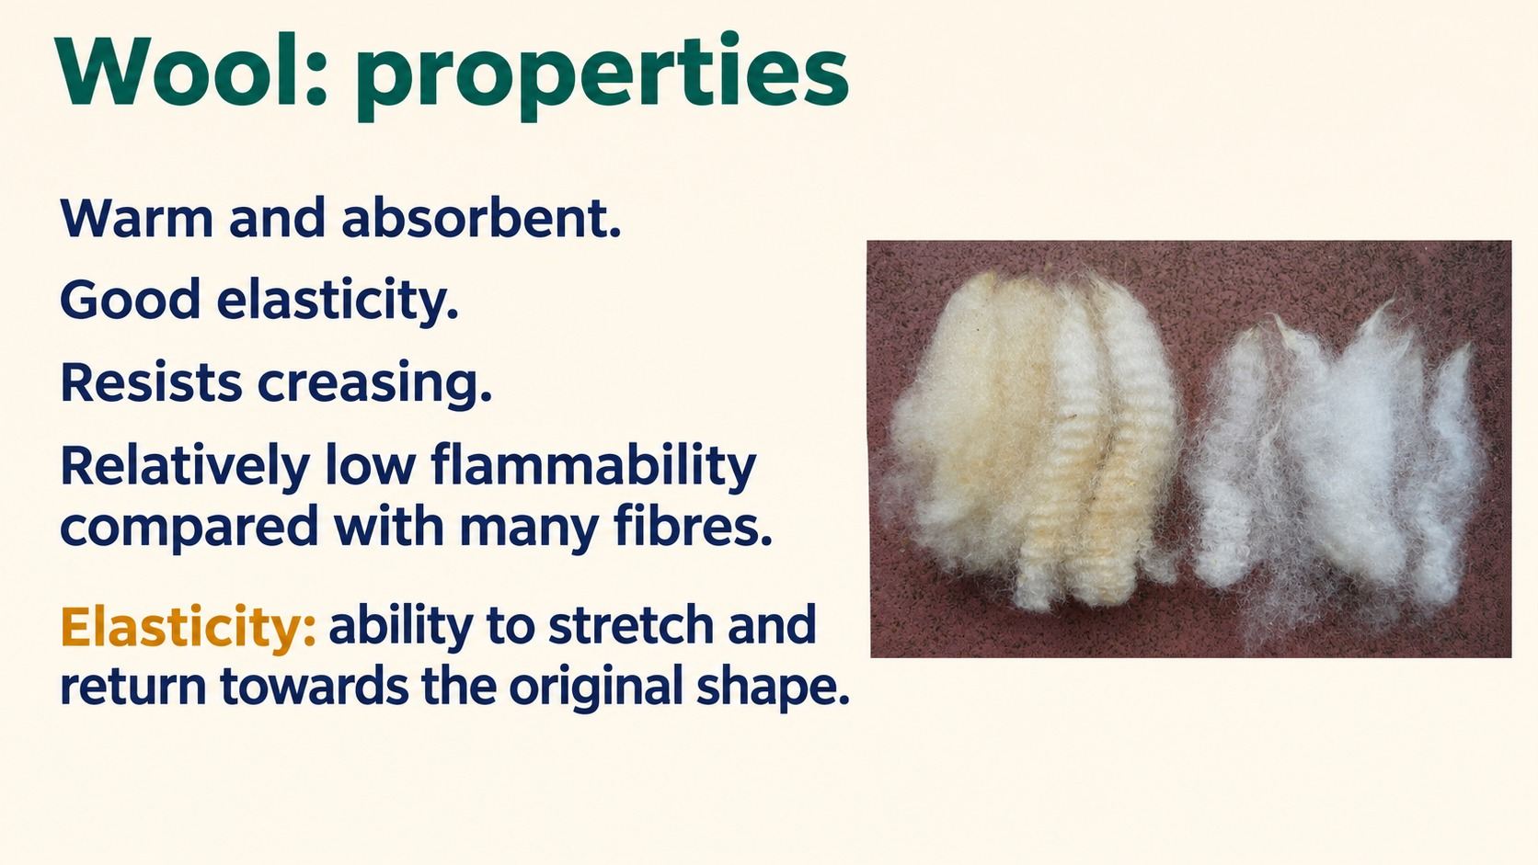
Notes:
Reference: Pearson Edexcel Design & Technology, supplied reference PDF, section 1.11, printed pages 32–34. Topic: Wool: properties. Slide artwork generated using sourced photographic references.
Performance ratings are textbook revision comparisons, not universal laboratory measurements. Warp knitting uses lengthwise yarns. Weft knitting forms crosswise rows.

Slide 7
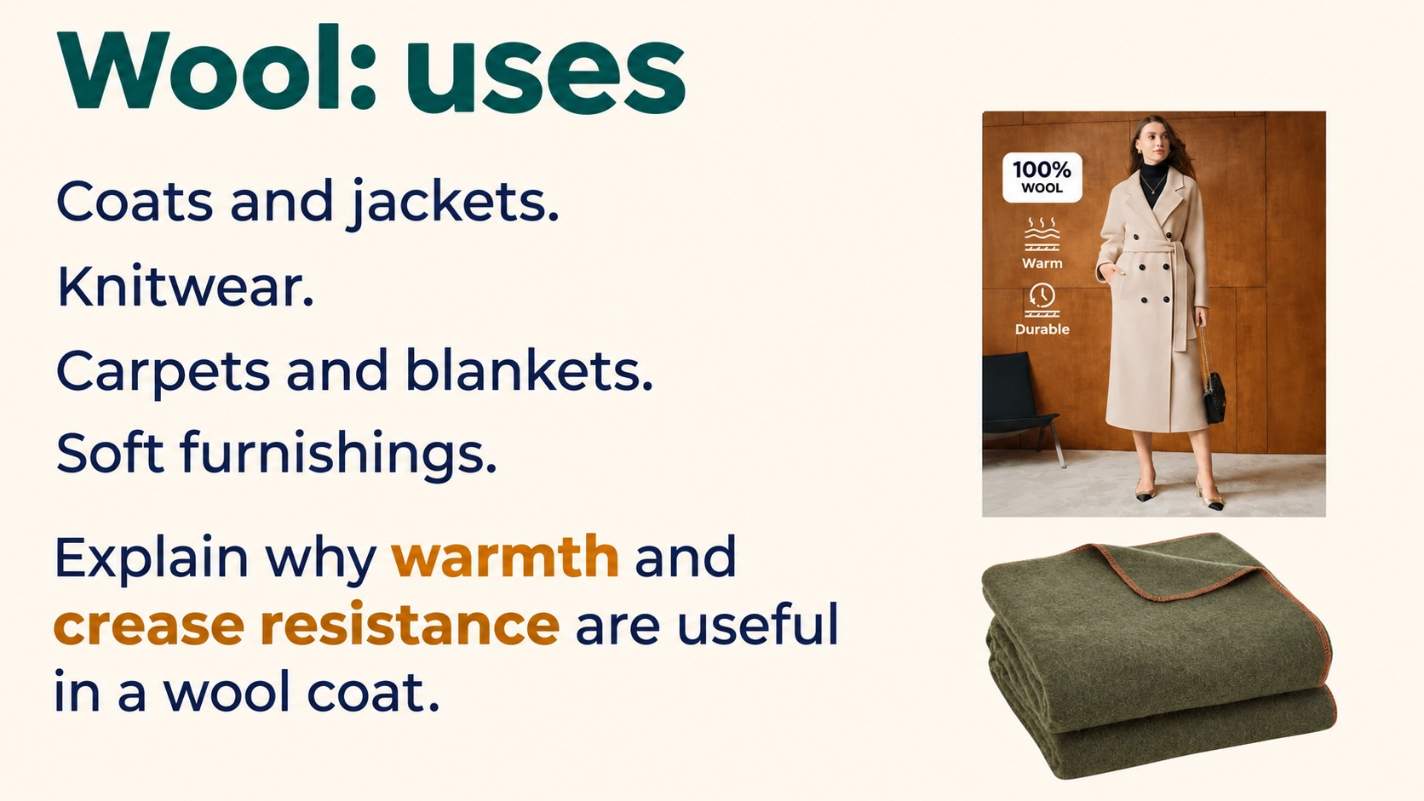
Notes:
Reference: Pearson Edexcel Design & Technology, supplied reference PDF, section 1.11, printed pages 32–34. Topic: Wool uses and benefits. Slide artwork generated using sourced photographic references.
Performance ratings are textbook revision comparisons, not universal laboratory measurements. Warp knitting uses lengthwise yarns. Weft knitting forms crosswise rows.

Slide 8
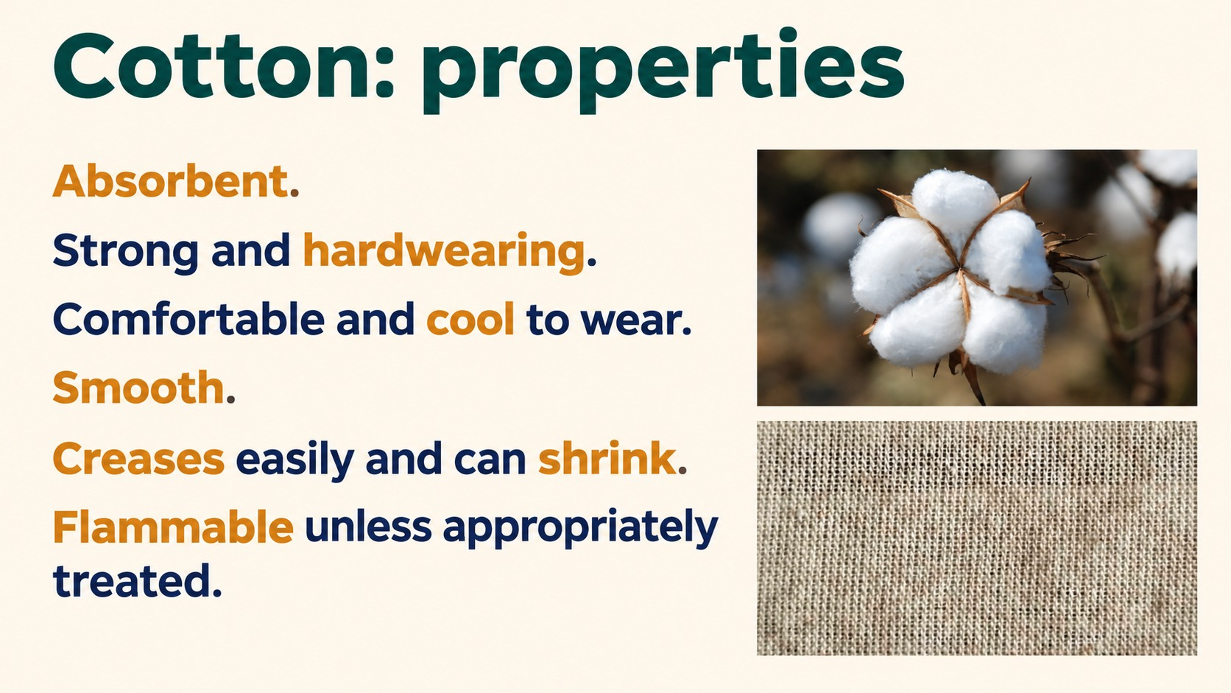
Notes:
Reference: Pearson Edexcel Design & Technology, supplied reference PDF, section 1.11, printed pages 32–34. Topic: Cotton: key properties. Slide artwork generated using sourced photographic references.
Performance ratings are textbook revision comparisons, not universal laboratory measurements. Warp knitting uses lengthwise yarns. Weft knitting forms crosswise rows.

Slide 9
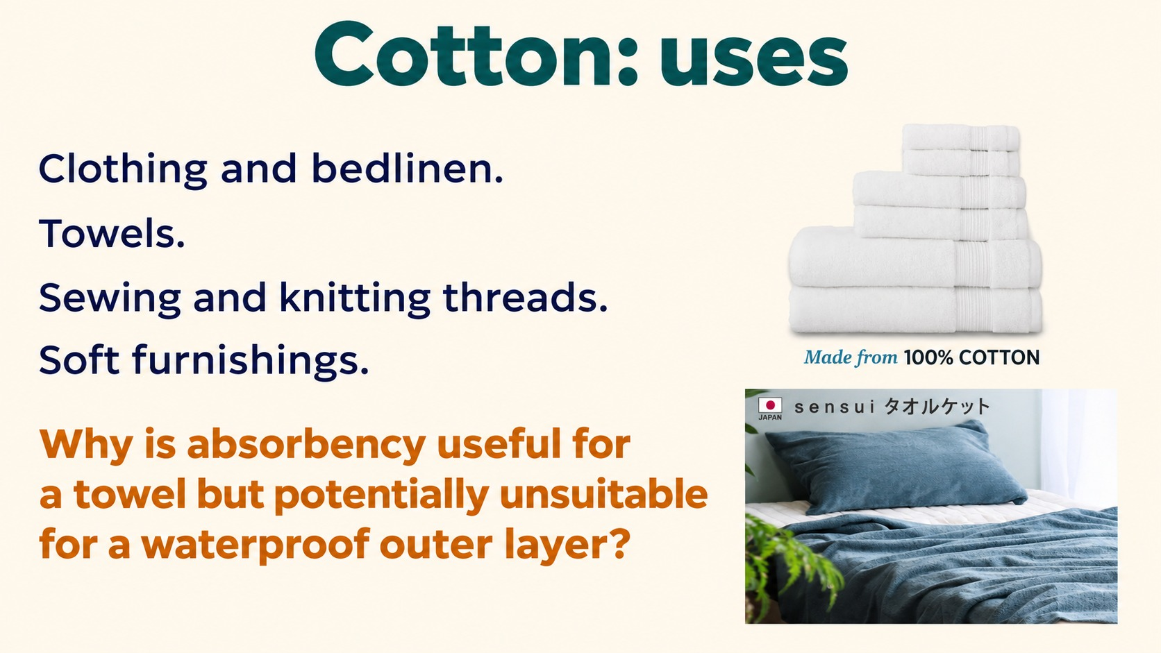
Notes:
Reference: Pearson Edexcel Design & Technology, supplied reference PDF, section 1.11, printed pages 32–34. Topic: Cotton uses and absorbency. Slide artwork generated using sourced photographic references.
Performance ratings are textbook revision comparisons, not universal laboratory measurements. Warp knitting uses lengthwise yarns. Weft knitting forms crosswise rows.

Slide 10
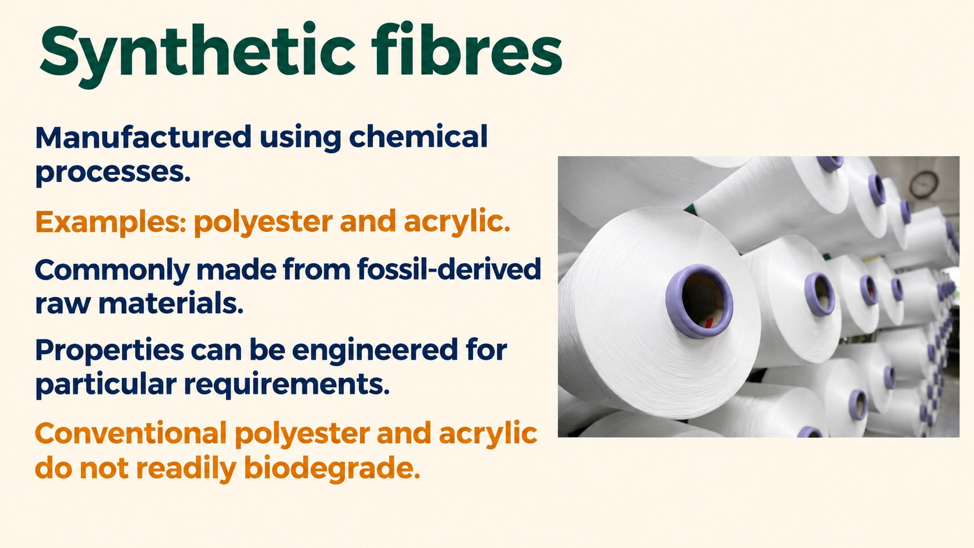
Notes:
Reference: Pearson Edexcel Design & Technology, supplied reference PDF, section 1.11, printed pages 32–34. Topic: Synthetic fibres. Slide artwork generated using sourced photographic references.
Performance ratings are textbook revision comparisons, not universal laboratory measurements. Warp knitting uses lengthwise yarns. Weft knitting forms crosswise rows.

Slide 11
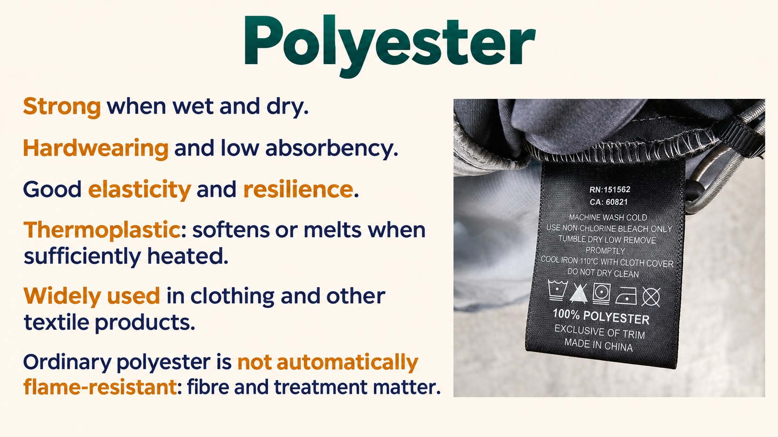
Notes:
Reference: Pearson Edexcel Design & Technology, supplied reference PDF, section 1.11, printed pages 32–34. Topic: Polyester: Strong, Durable, Versatile Fiber. Slide artwork generated using sourced photographic references.
Performance ratings are textbook revision comparisons, not universal laboratory measurements. Warp knitting uses lengthwise yarns. Weft knitting forms crosswise rows.

Slide 12
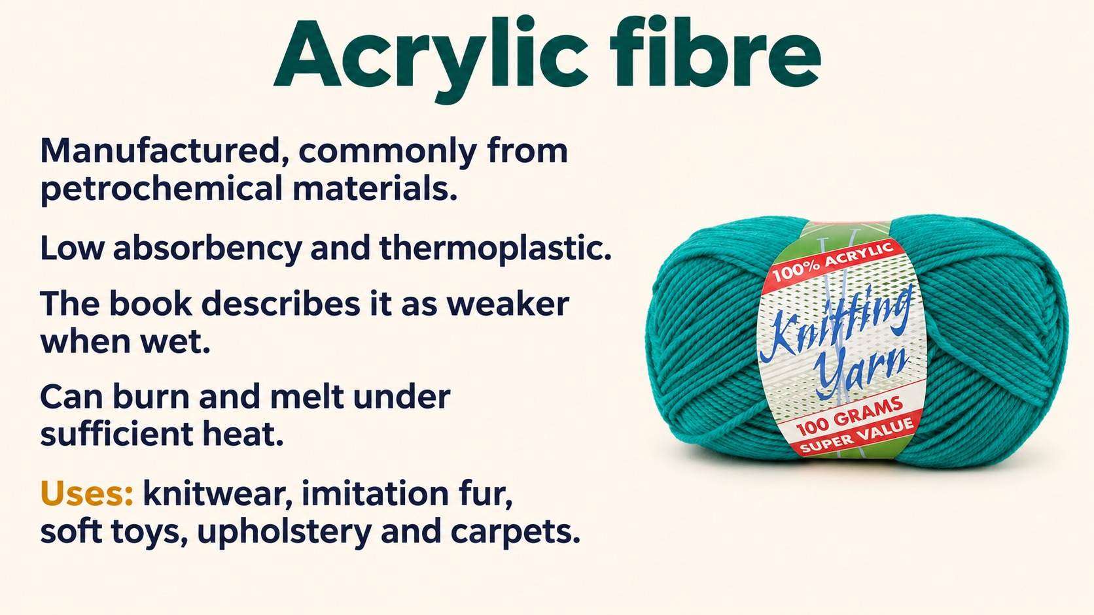
Notes:
Reference: Pearson Edexcel Design & Technology, supplied reference PDF, section 1.11, printed pages 32–34. Topic: Acrylic fibre. Slide artwork generated using sourced photographic references.
Performance ratings are textbook revision comparisons, not universal laboratory measurements. Warp knitting uses lengthwise yarns. Weft knitting forms crosswise rows.

Slide 13
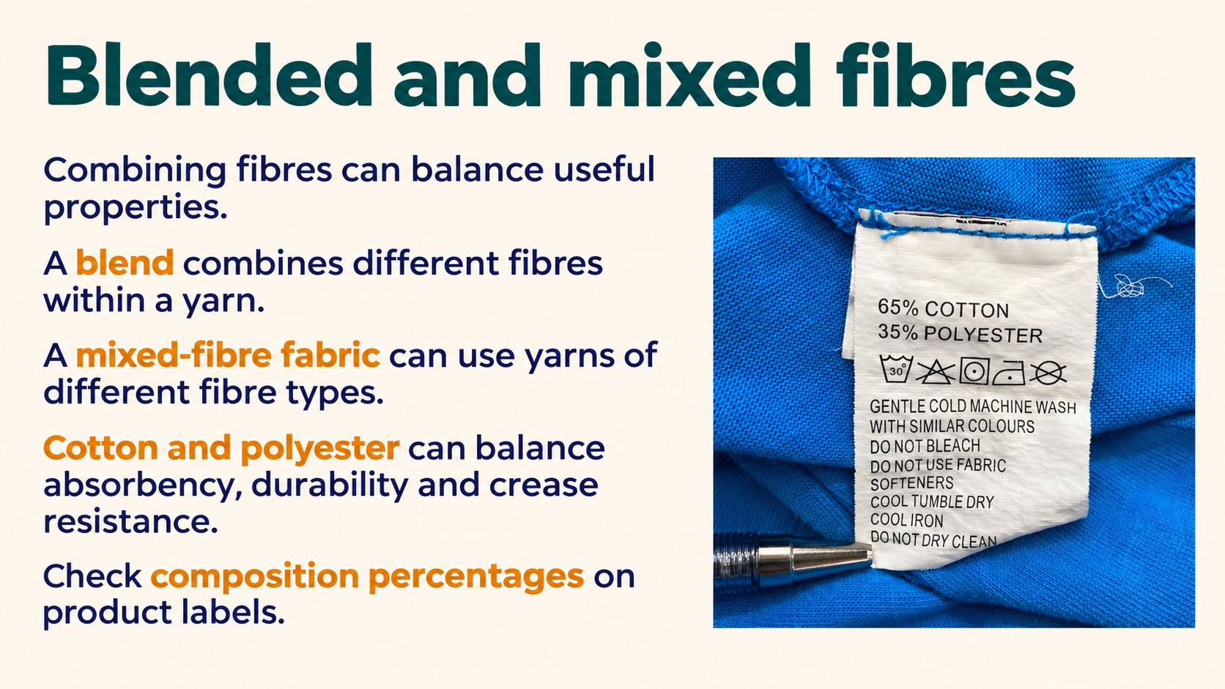
Notes:
Reference: Pearson Edexcel Design & Technology, supplied reference PDF, section 1.11, printed pages 32–34. Topic: Blended and mixed fibres. Slide artwork generated using sourced photographic references.
Performance ratings are textbook revision comparisons, not universal laboratory measurements. Warp knitting uses lengthwise yarns. Weft knitting forms crosswise rows.

Slide 14
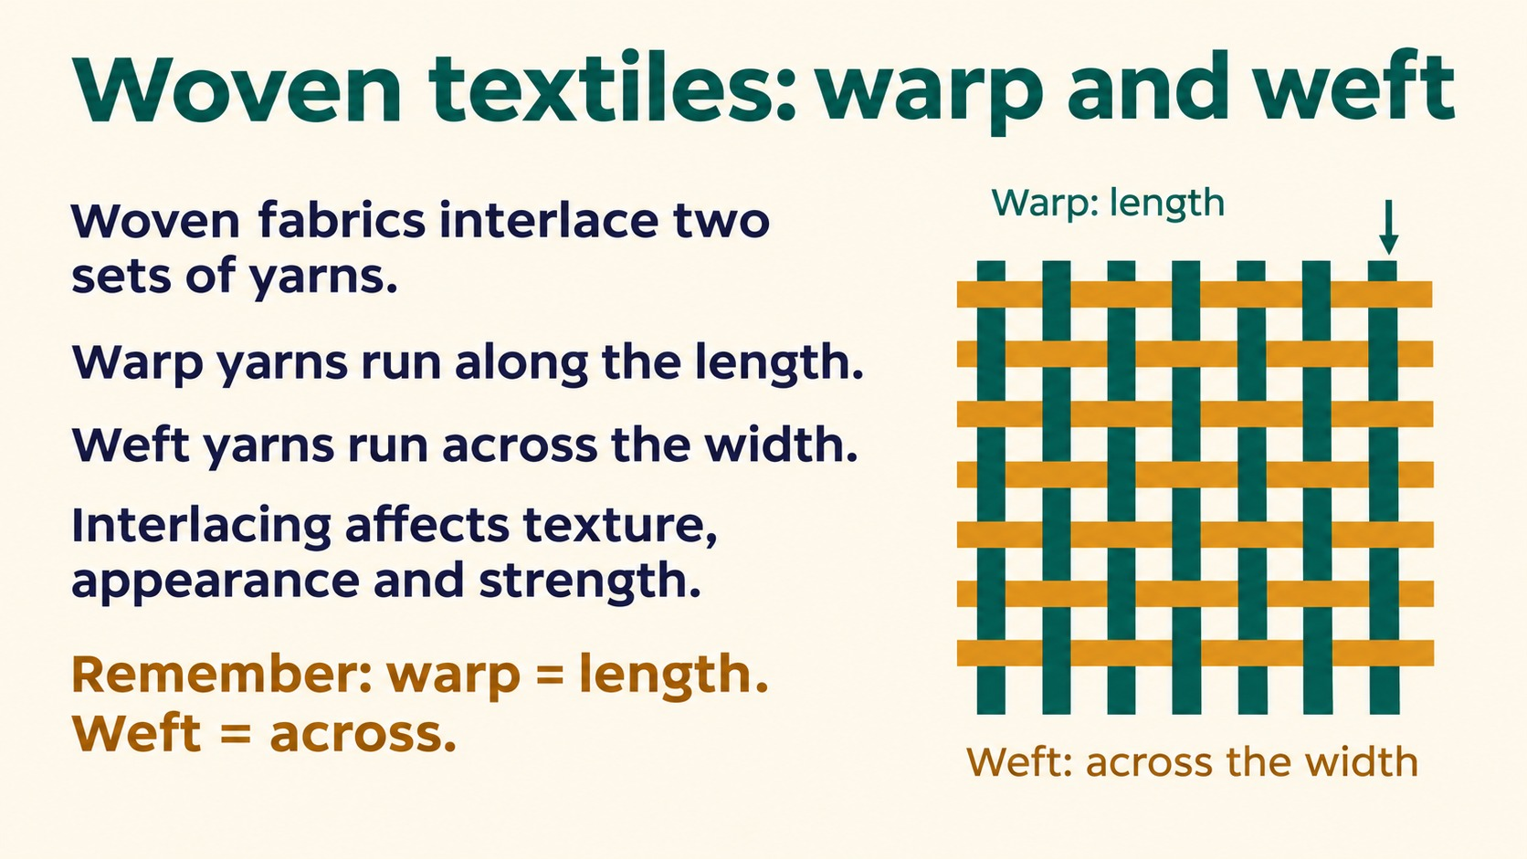
Notes:
Reference: Pearson Edexcel Design & Technology, supplied reference PDF, section 1.11, printed pages 32–34. Topic: Woven textiles: warp and weft. Slide artwork generated using sourced photographic references.
Performance ratings are textbook revision comparisons, not universal laboratory measurements. Warp knitting uses lengthwise yarns. Weft knitting forms crosswise rows.

Slide 15
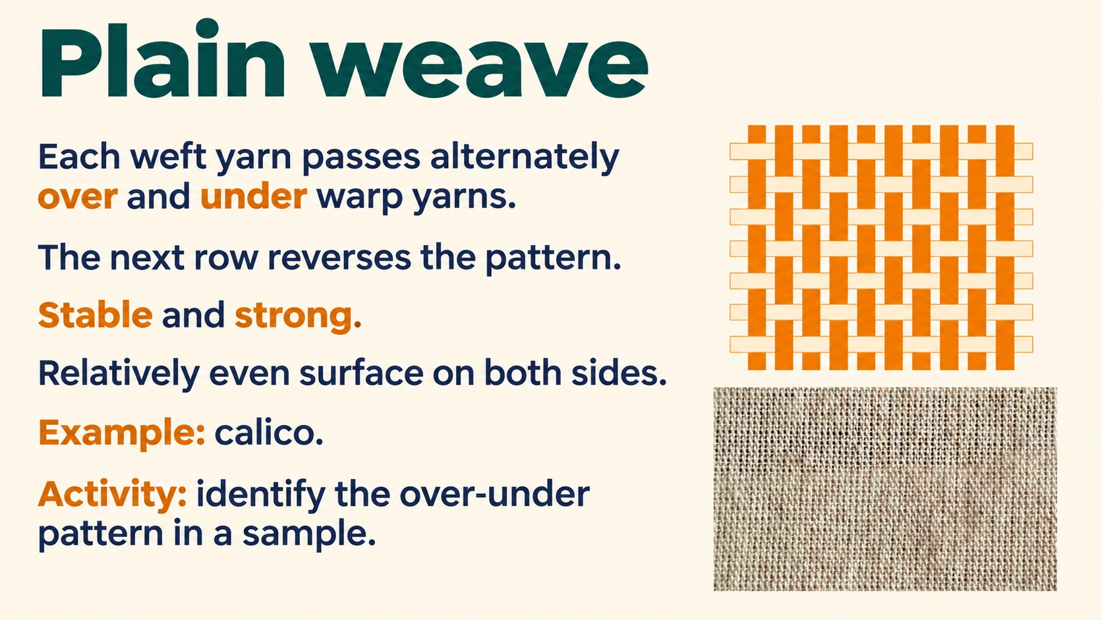
Notes:
Reference: Pearson Edexcel Design & Technology, supplied reference PDF, section 1.11, printed pages 32–34. Topic: Plain weave. Slide artwork generated using sourced photographic references.
Performance ratings are textbook revision comparisons, not universal laboratory measurements. Warp knitting uses lengthwise yarns. Weft knitting forms crosswise rows.

Slide 16
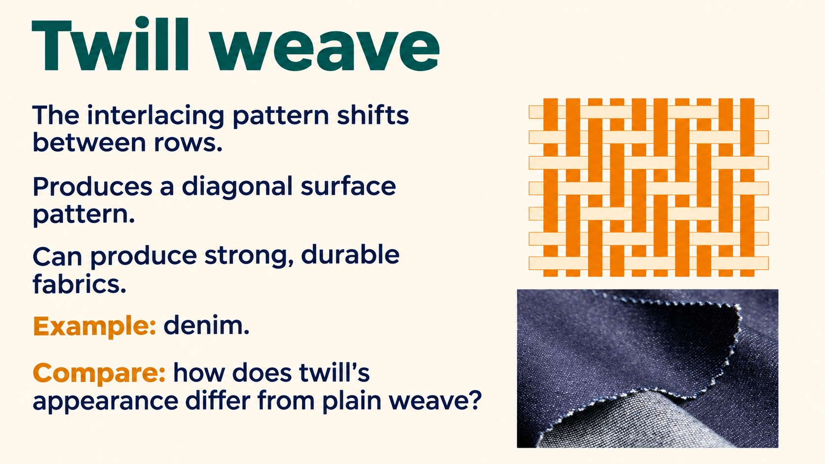
Notes:
Reference: Pearson Edexcel Design & Technology, supplied reference PDF, section 1.11, printed pages 32–34. Topic: Twill weave pattern. Slide artwork generated using sourced photographic references.
Performance ratings are textbook revision comparisons, not universal laboratory measurements. Warp knitting uses lengthwise yarns. Weft knitting forms crosswise rows.

Slide 17
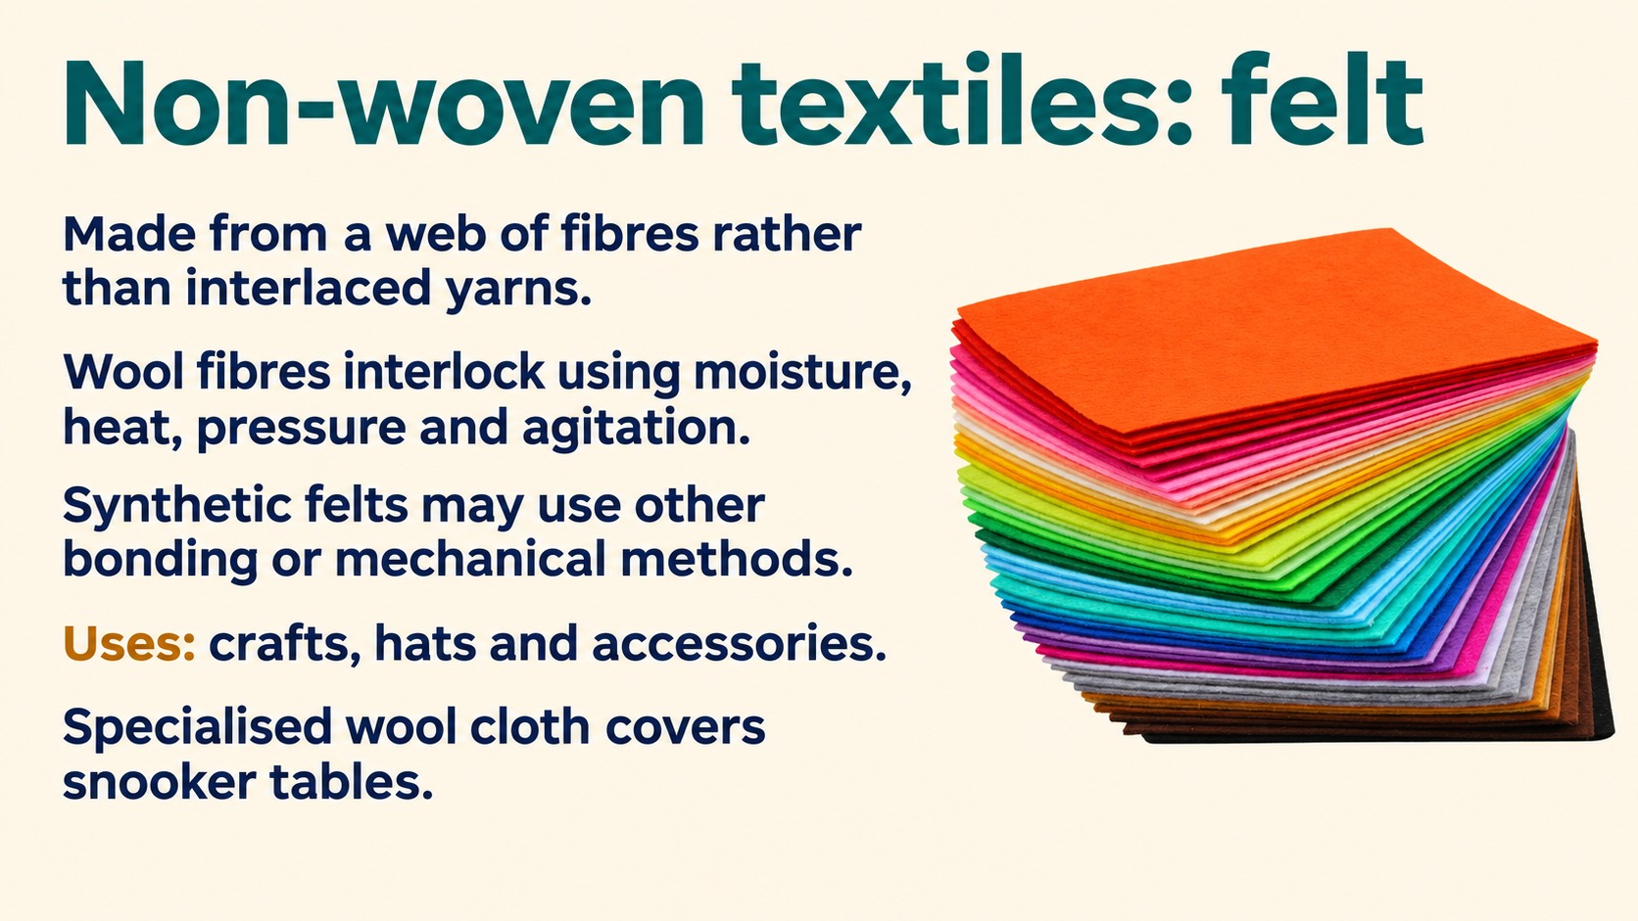
Notes:
Reference: Pearson Edexcel Design & Technology, supplied reference PDF, section 1.11, printed pages 32–34. Topic: Non-woven textiles: felt. Slide artwork generated using sourced photographic references.
Performance ratings are textbook revision comparisons, not universal laboratory measurements. Warp knitting uses lengthwise yarns. Weft knitting forms crosswise rows.

Slide 18
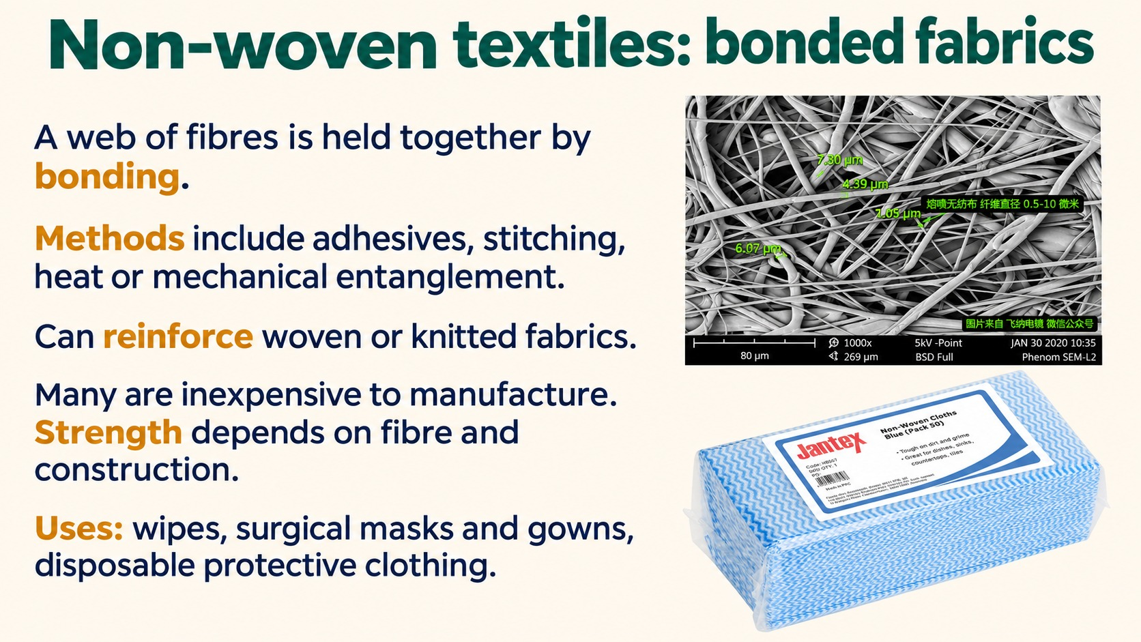
Notes:
Reference: Pearson Edexcel Design & Technology, supplied reference PDF, section 1.11, printed pages 32–34. Topic: Bonded non-woven textiles. Slide artwork generated using sourced photographic references.
Performance ratings are textbook revision comparisons, not universal laboratory measurements. Warp knitting uses lengthwise yarns. Weft knitting forms crosswise rows.

Slide 19
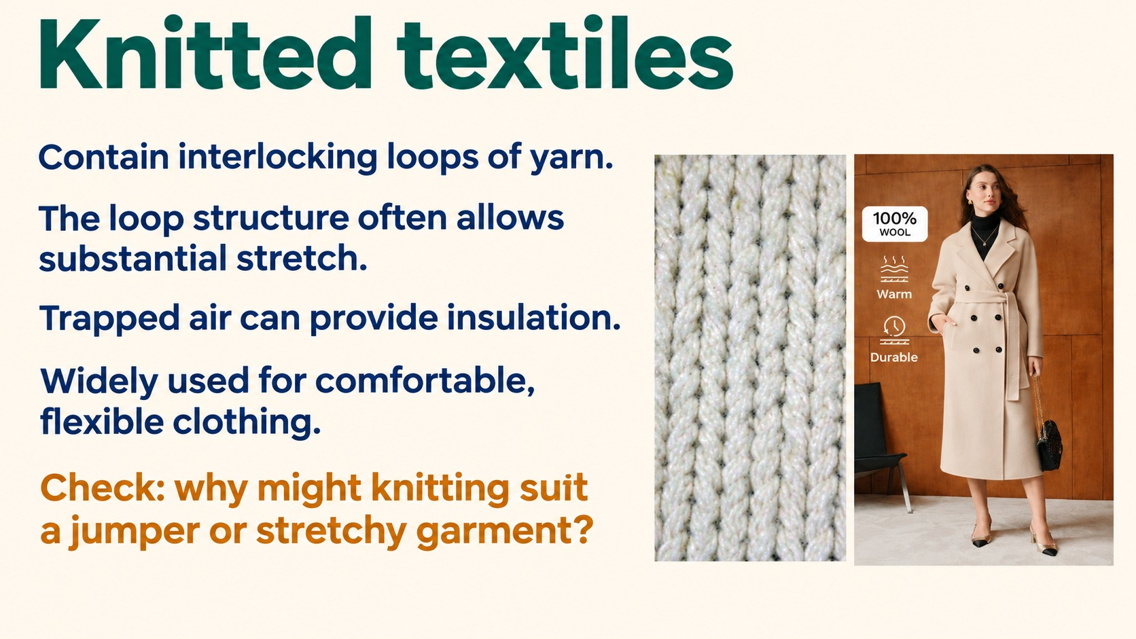
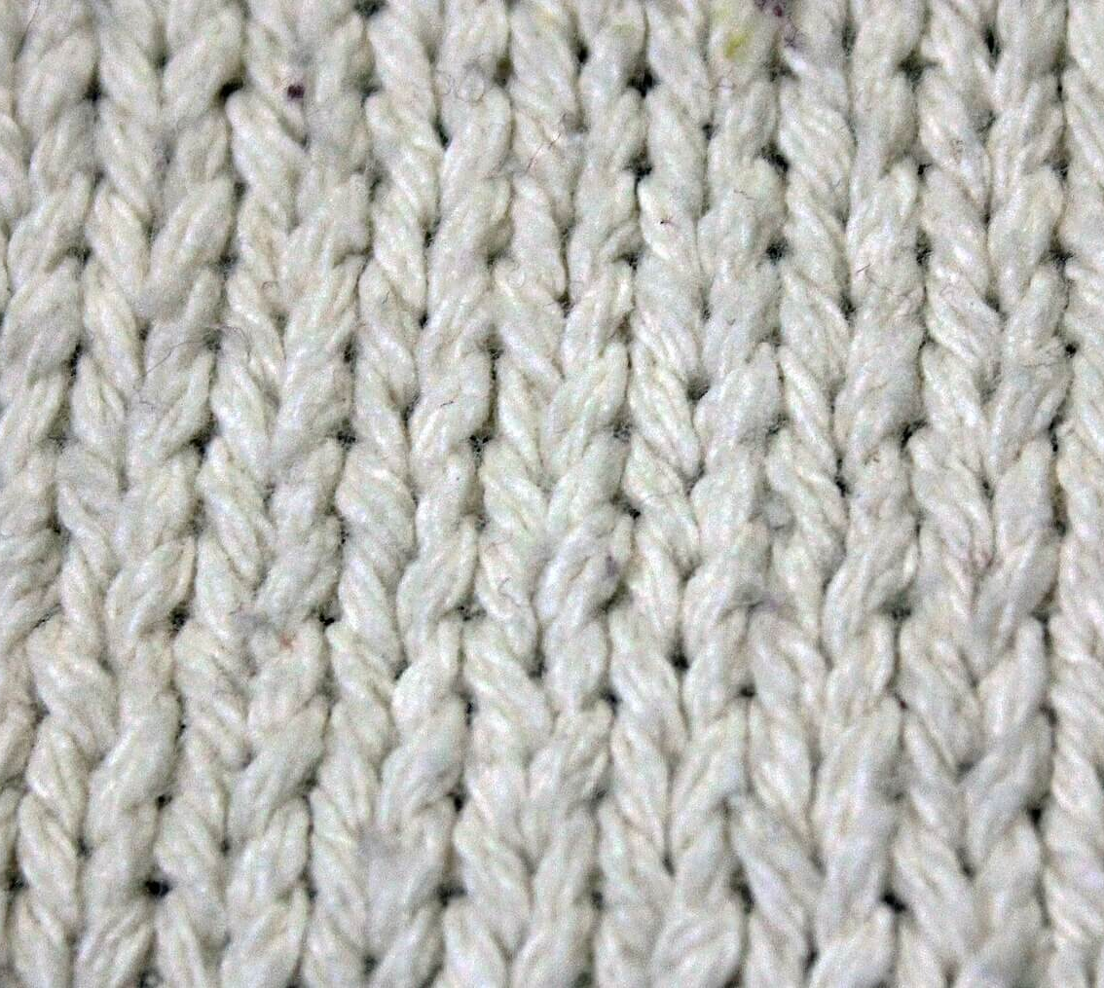
Notes:
Reference: Pearson Edexcel Design & Technology, supplied reference PDF, section 1.11, printed pages 32–34. Topic: Knitted textiles. Slide artwork generated using sourced photographic references.
Performance ratings are textbook revision comparisons, not universal laboratory measurements. Warp knitting uses lengthwise yarns. Weft knitting forms crosswise rows.
Knit photograph: https://wcn-media.s3.us-west-004.backblazeb2.com/2025/11/Gfp-white-yard-texture.jpg

Slide 20
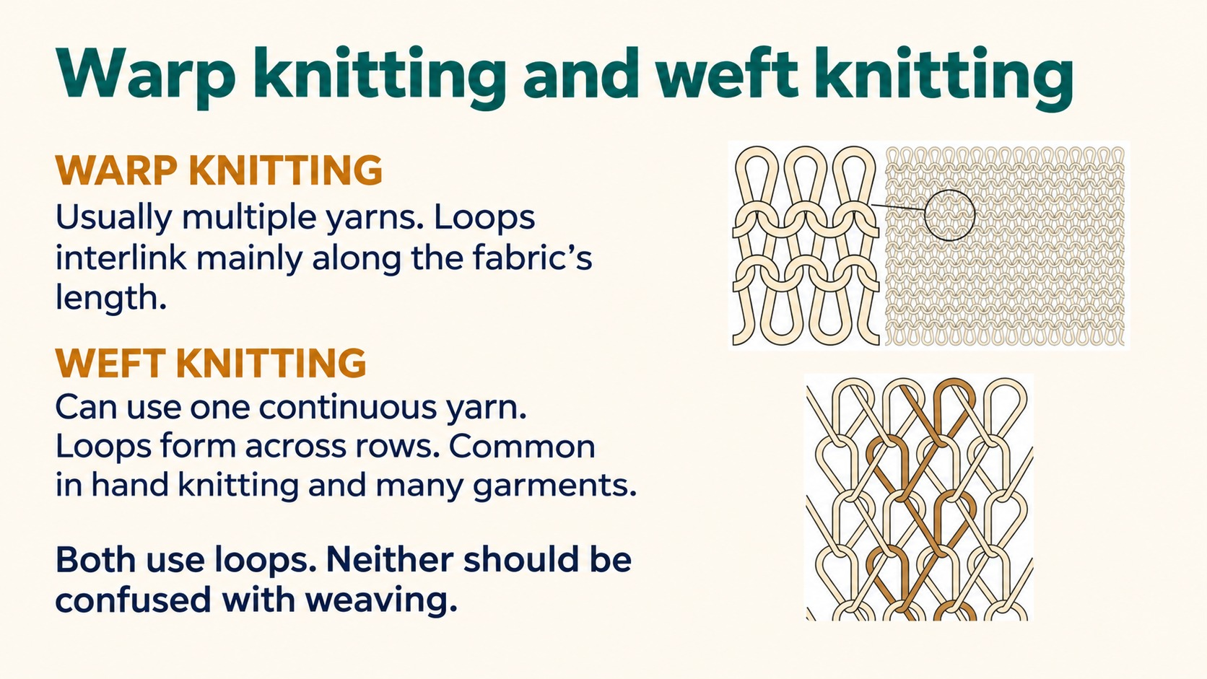
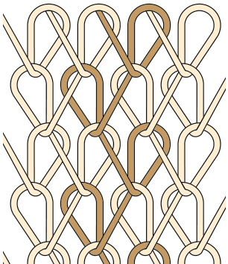
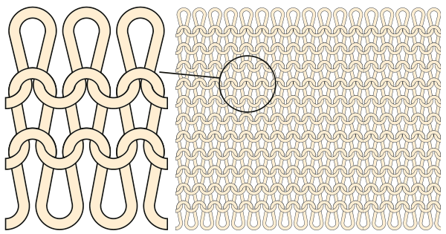
Warp knitting
Weft knitting
Notes:
Reference: Pearson Edexcel Design & Technology, supplied reference PDF, section 1.11, printed pages 32–34. Topic: Warp and weft knitting comparison. Slide artwork generated using sourced photographic references.
Performance ratings are textbook revision comparisons, not universal laboratory measurements. Warp knitting uses lengthwise yarns. Weft knitting forms crosswise rows.
Knitting diagrams extracted from reference PDF, page 34. Labels corrected to match standard terminology. Verification: https://cottonworks.com/learning-hub/knitting/knit-basics/

Slide 21
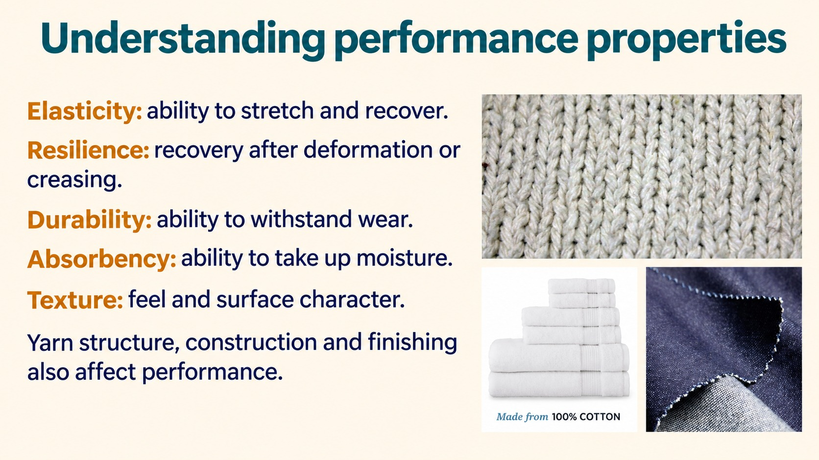
Notes:
Reference: Pearson Edexcel Design & Technology, supplied reference PDF, section 1.11, printed pages 32–34. Topic: Understanding performance properties. Slide artwork generated using sourced photographic references.
Performance ratings are textbook revision comparisons, not universal laboratory measurements. Warp knitting uses lengthwise yarns. Weft knitting forms crosswise rows.

Slide 22
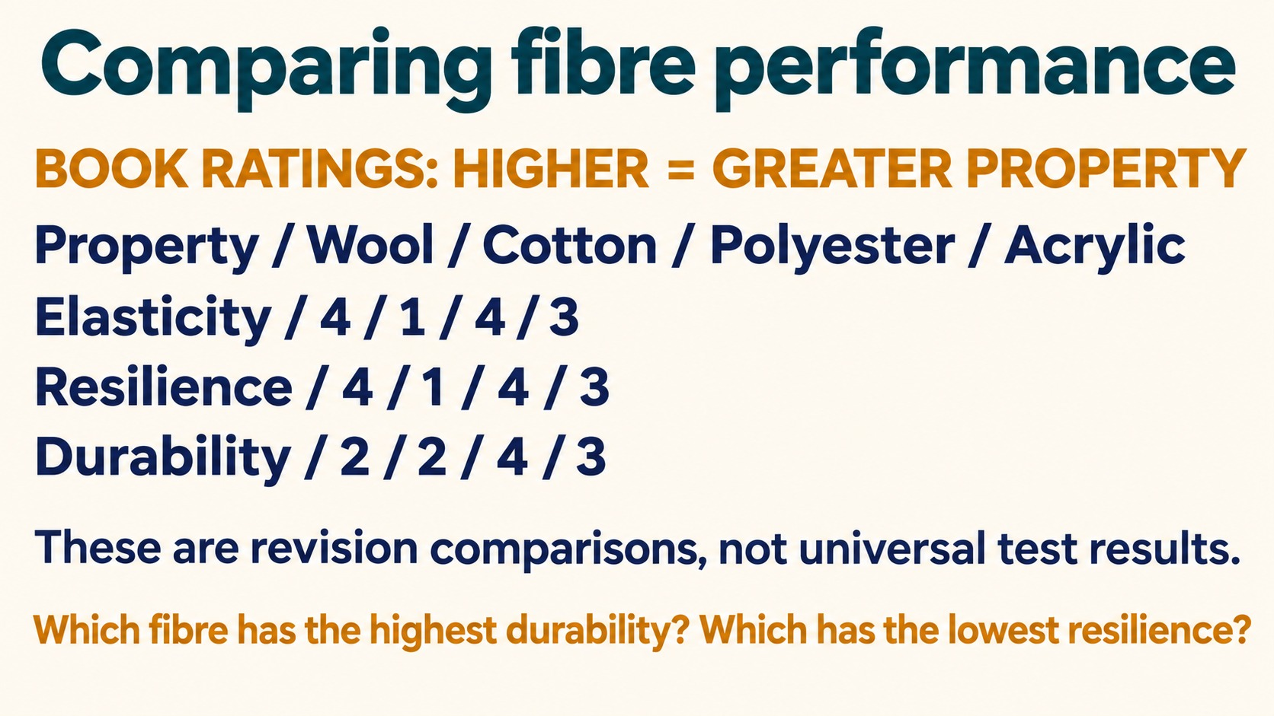
Property | Wool | Cotton | Polyester | Acrylic
Elasticity | 4 | 1 | 4 | 3
Resilience | 4 | 1 | 4 | 3
Durability | 2 | 2 | 4 | 3
Notes:
Reference: Pearson Edexcel Design & Technology, supplied reference PDF, section 1.11, printed pages 32–34. Topic: Comparing fibre performance. Slide artwork generated using sourced photographic references.
Performance ratings are textbook revision comparisons, not universal laboratory measurements. Warp knitting uses lengthwise yarns. Weft knitting forms crosswise rows.
Answers: polyester has highest durability (4), cotton has lowest resilience (1).

Slide 23
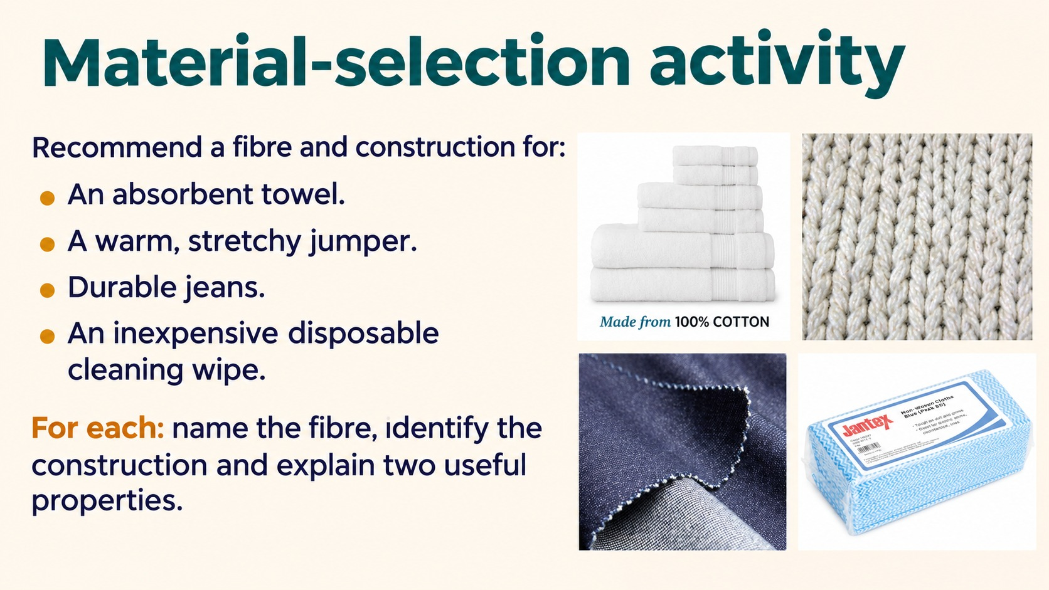
Notes:
Reference: Pearson Edexcel Design & Technology, supplied reference PDF, section 1.11, printed pages 32–34. Topic: Material-selection activity. Slide artwork generated using sourced photographic references.
Performance ratings are textbook revision comparisons, not universal laboratory measurements. Warp knitting uses lengthwise yarns. Weft knitting forms crosswise rows.

Slide 24
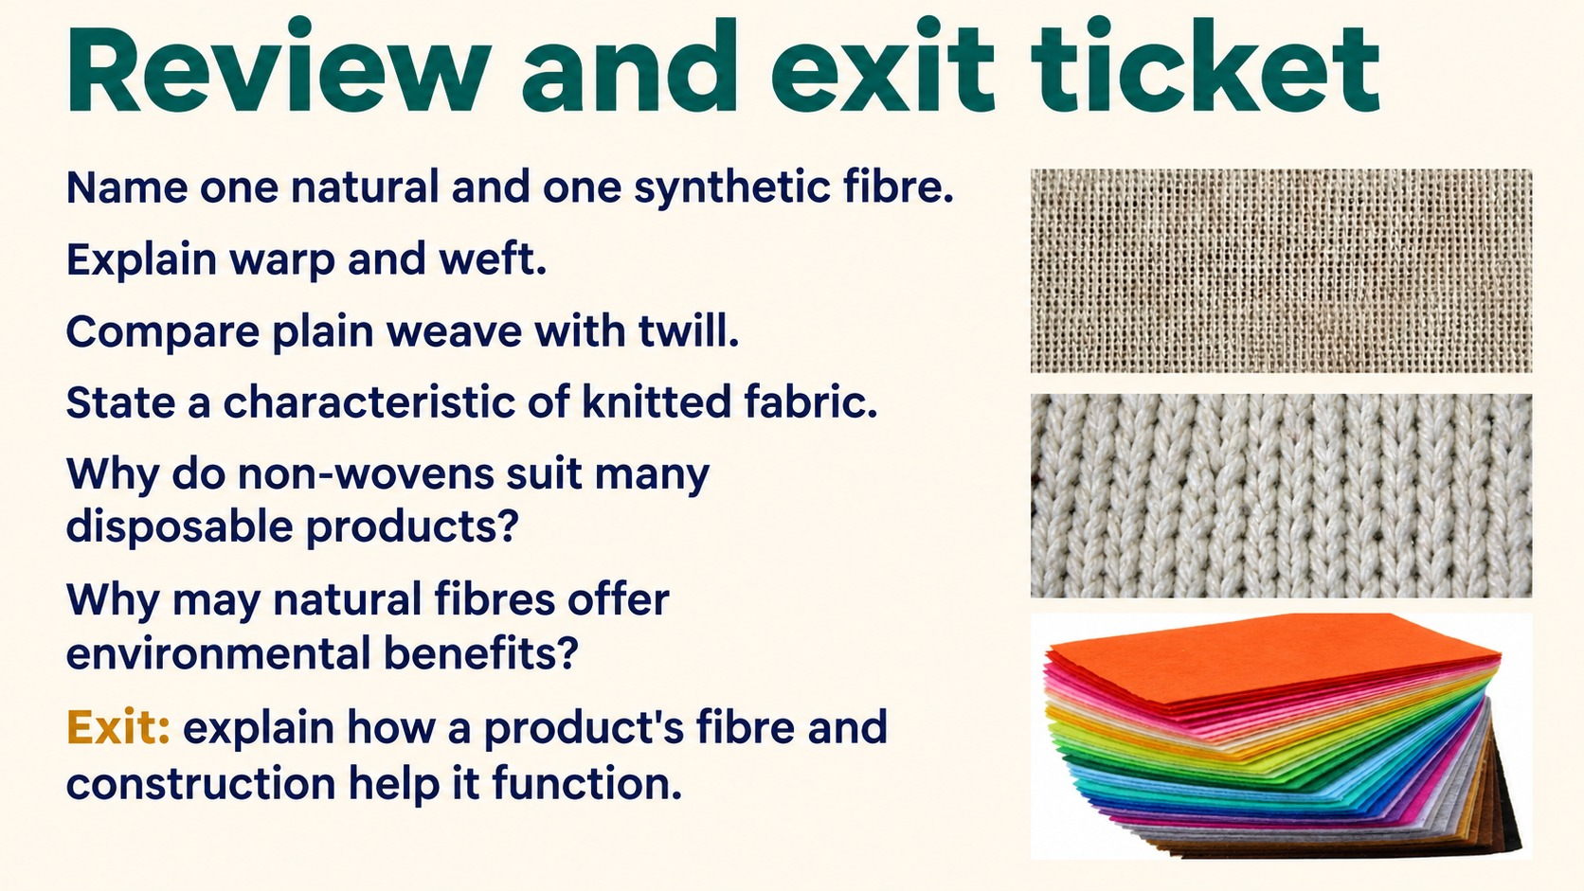
Notes:
Reference: Pearson Edexcel Design & Technology, supplied reference PDF, section 1.11, printed pages 32–34. Topic: Review and exit ticket(2). Slide artwork generated using sourced photographic references.
Performance ratings are textbook revision comparisons, not universal laboratory measurements. Warp knitting uses lengthwise yarns. Weft knitting forms crosswise rows.

